Slide 1
Unit 10: Regression

Slide 2
The Data Science Pipeline

Slide 3
Lightboard SLR | First Principles

Slide 4
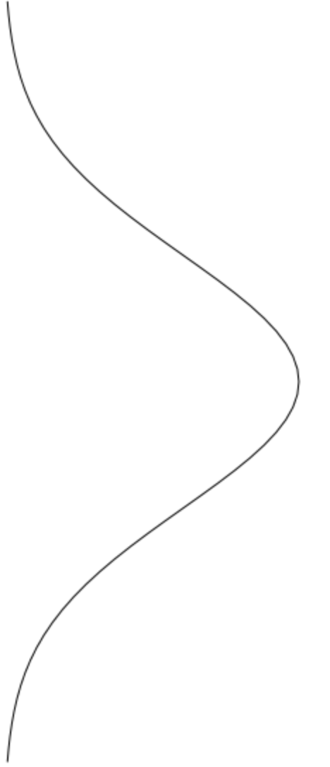
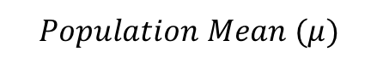
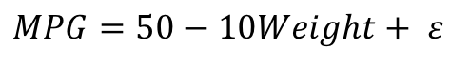

First Two Assumptions
$$Population Mean (μ)$$
$$Observation$$
MPG
$$MPG=50−10Weight+ ε$$
Weight

Slide 5
SLR | Practical Setting

Slide 6
First Two Assumptions
$$Population Mean (μ)$$
$$Observation$$
Assumptions:
Subpopulations of mpgs for a fixed weight are normally distributed.
The means of the distributions of mpgs are linearly related to weight.
MPG
Weight

Slide 7
First Two Assumptions (Another Sample)
$$Population Mean (μ)$$
$$Observation$$
Assumptions:
Subpopulations of mpgs for a fixed weight are normally distributed.
The means of the distributions of mpgs are linearly related to weight.
MPG
Weight

Slide 8
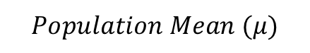

First Two Assumptions
$$Population Mean (μ)$$
$$Observation$$
Horse Power
Assumptions:
Subpopulations of mpgs for a fixed weight are normally distributed.
The means of the distributions of mpgs are linearly related to weight.
Weight

Slide 9
First Two Assumptions
$$Population Mean (μ)$$
$$Observation$$
Horse Power
Assumptions:
Subpopulations of mpgs for a fixed weight are normally distributed.
The means of the distributions of mpgs are linearly related to weight.
Weight

Slide 10
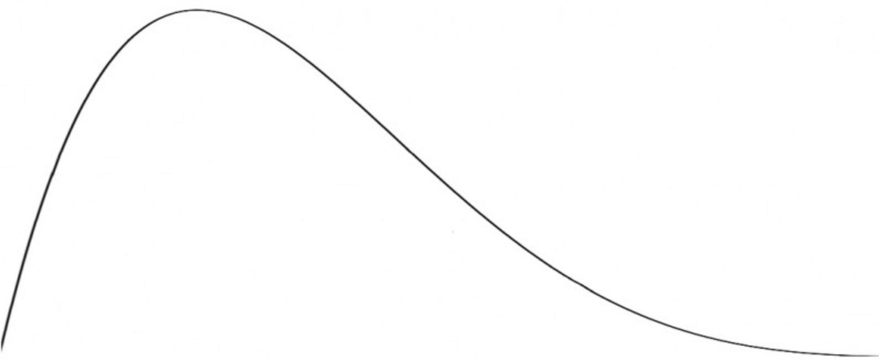

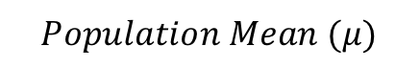
First Two Assumptions
$$Population Mean (μ)$$
$$Observation$$
Horse Power
Assumptions:
Subpopulations of mpgs for a fixed weight are normally distributed.
The means of the distributions of mpgs are linearly related to weight.
Weight

Slide 11
First Two Assumptions
$$Population Mean (μ)$$
$$Observation$$
Y
Assumptions:
Subpopulations of mpgs for a fixed weight are normally distributed.
The means of the distributions of mpgs are linearly related to weight.
X

Slide 12
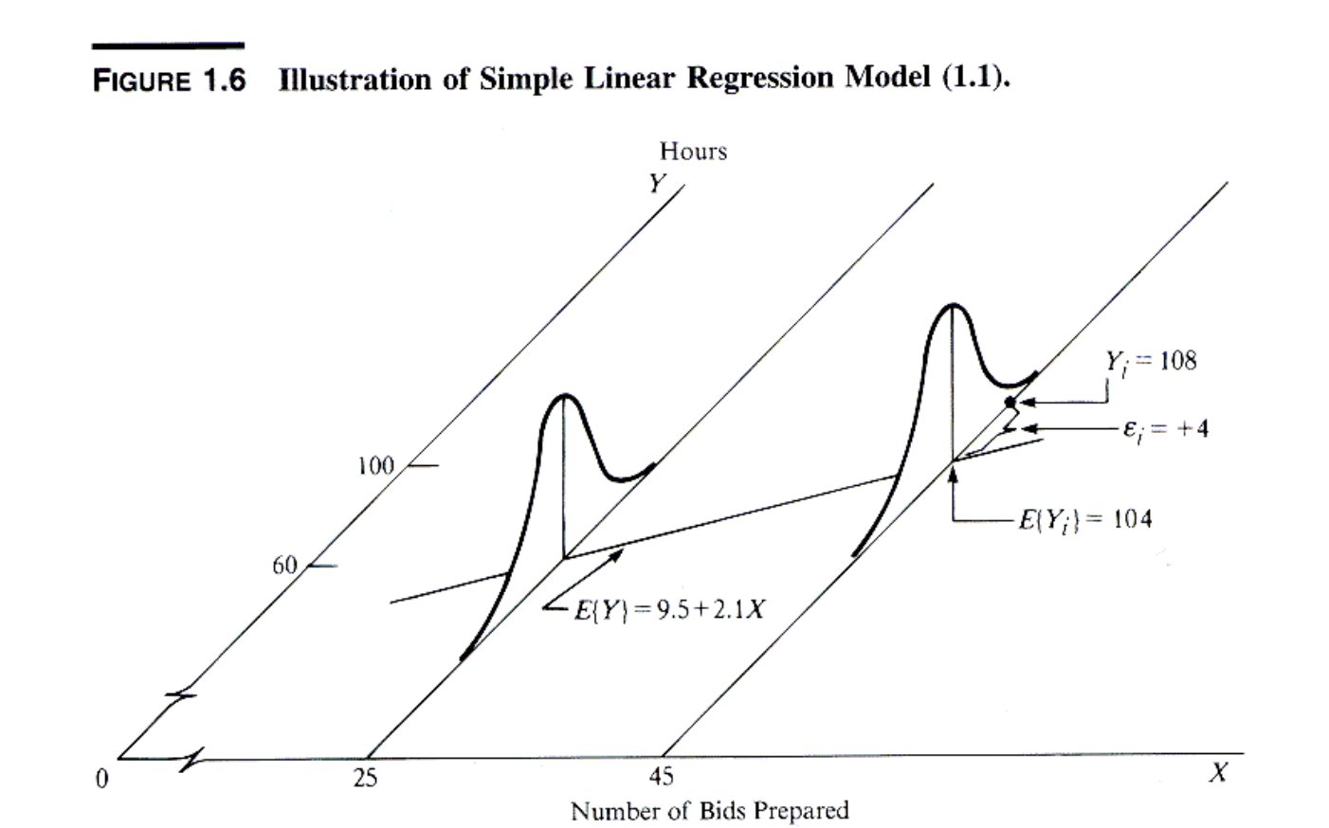
Source: Francois Nielsen
Summary
Assumptions:
Subpopulations of Hours for a fixed number of bids prepared are normally distributed.
The means of the normal distributions of Hours are linearly related to the number of bids prepared.

Slide 14
SLR | Interpretation: Intercept and Slope

Slide 15
Interpreting the Intercept and Slope
$$Population Mean (μ)$$
$$Observation$$
Interpretation:
Intercept: A car that weighs 0lbs is estimated to get 50mpg.
Extrapolation!
Slope: For each additional 1,000 lbs added to the car, the car is estimated to get 10 less mpg.
MPG
$$MPG=50−10Weight+ ε$$
Weight

Slide 16
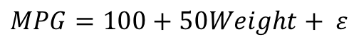
Interpreting the Intercept and Slope
$$Population Mean (μ)$$
$$Observation$$
Interpretation:
Intercept: A car that weighs 0lbs is estimated to have 100 horsepower
Extrapolation!
Slope: For each additional 1,000 lbs added to a car, a car is estimated to have 50 more horsepower.
Horse Power
$$MPG=100+50Weight+ ε$$
Weight

Slide 17
Concept Check
$$Population Mean (μ)$$
$$Observation$$
Horse Power
Interpret
What is the correct interpretation of the intercept?
What is the correct interpretation of the slope?
$$MPG=100+50Weight+ ε$$
Weight

Slide 19
SLR | Prediction

Slide 20
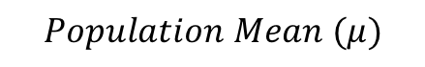
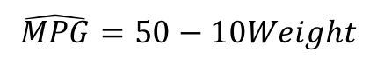
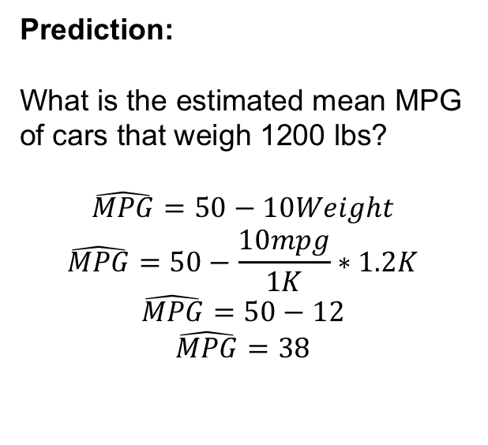
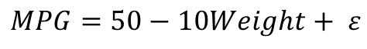

Prediction
$$Population Mean (μ)$$
Prediction:
What is the estimated mean MPG of cars that weigh 1200 lbs?
$$\hat{MPG}=50−10Weight$$
$$\hat{MPG}=50−\frac{10mpg}{1K}∗1.2K$$
$$\hat{MPG}=50−12$$
$$\hat{MPG}=38$$
$$Observation$$
MPG
Given the data, we estimate that cars that weigh 1200 lbs will have a mean mpg of 38.
$$MPG=50−10Weight+ ε$$
$$\hat{MPG}=50−10Weight$$
Weight

Slide 21
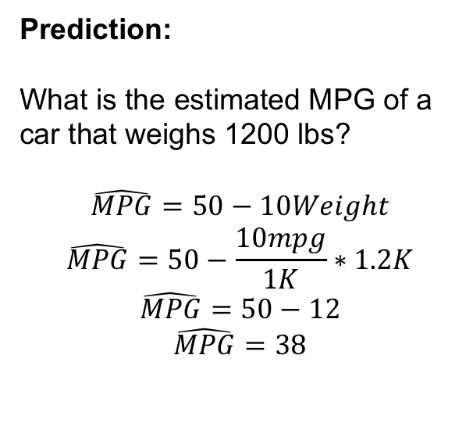
Prediction
$$Population Mean (μ)$$
Prediction:
What is the estimated MPG of a car that weighs 1200 lbs?
$$\hat{MPG}=50−10Weight$$
$$\hat{MPG}=50−\frac{10mpg}{1K}∗1.2K$$
$$\hat{MPG}=50−12$$
$$\hat{MPG}=38$$
$$Observation$$
MPG
Given the data, we estimate that a car that weighs 1200 lbs will get 38 miles per gallon.
$$MPG=50−10Weight+ ε$$
$$\hat{MPG}=50−10Weight$$
Weight

Slide 22
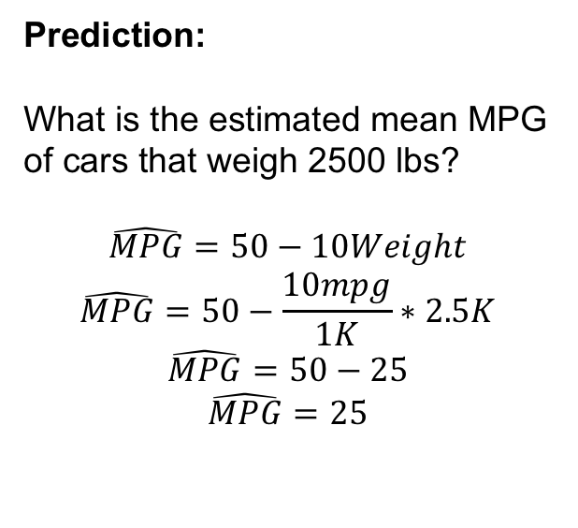
Prediction
$$Population Mean (μ)$$
Prediction:
What is the estimated mean MPG of cars that weigh 2500 lbs?
$$\hat{MPG}=50−10Weight$$
$$\hat{MPG}=50−\frac{10mpg}{1K}∗2.5K$$
$$\hat{MPG}=50−25$$
$$\hat{MPG}=25$$
$$Observation$$
MPG
Given the data, we estimate that cars that weigh 2500 lbs will have a mean mpg of 25.
$$MPG=50−10Weight+ ε$$
$$\hat{MPG}=50−10Weight$$
Weight

Slide 23
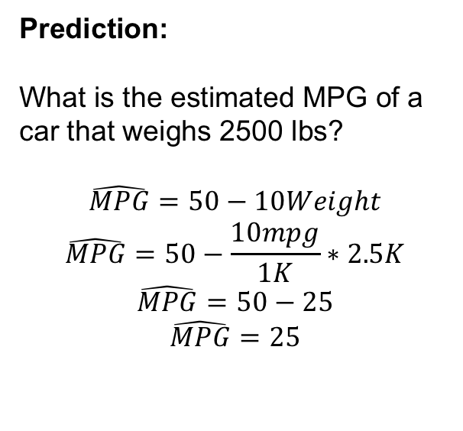
Prediction
$$Population Mean (μ)$$
Prediction:
What is the estimated MPG of a car that weighs 2500 lbs?
$$\hat{MPG}=50−10Weight$$
$$\hat{MPG}=50−\frac{10mpg}{1K}∗2.5K$$
$$\hat{MPG}=50−25$$
$$\hat{MPG}=25$$
$$Observation$$
MPG
Given the data, we estimate that a car that weighs 2500 lbs will get 25 miles per gallon.
$$MPG=50−10Weight+ ε$$
$$\hat{MPG}=50−10Weight$$
Weight

Slide 24
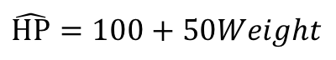
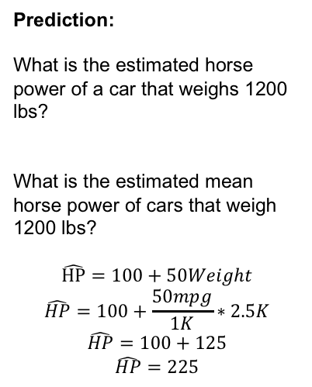
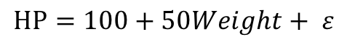
Concept Check
$$Population Mean (μ)$$
$$Observation$$
Prediction:
What is the estimated horse power of a car that weighs 1200 lbs?
What is the estimated mean horse power of cars that weigh 1200 lbs?
$$\hat{HP}=100+50Weight$$
$$\hat{HP}=100+\frac{50mpg}{1K}∗2.5K$$
$$\hat{HP}=100+125$$
$$\hat{HP}=225$$
Horse Power
$$HP=100+50Weight+ ε$$
$$\hat{HP}=100+50Weight$$
Weight

Slide 26
Lightboard | Residuals / SSE

Slide 27
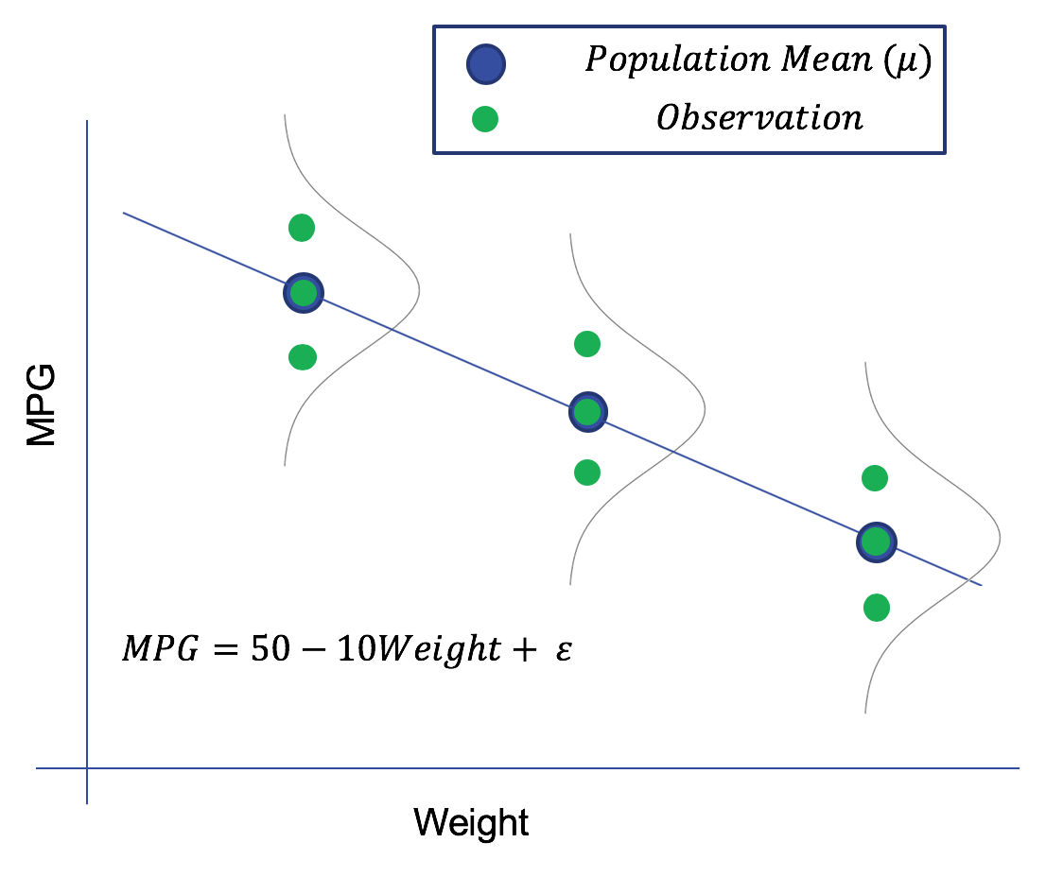
Residuals / SSE
We will draw a coordinate plane with points and a regression line and draw what the ”residual” is.
We will make the point that a point on the regression line has residual zero.
We will ask what the sum of the residuals of a perfect fitting line would be.
We will then add up the residuals and show that they could cancel each other out and equal zero even though the line does not fit the data perfectly.
We will then sum the squared residuals and note that statistic as the SSE or SSR.

Slide 29
Concept Check
Given data and a line… calculate the sum of the residuals and the sum of the squared residuals.

Slide 31
Least Squares Regression Line

Slide 32
Least Squares Regression Line
#Unit 10 R Code
library(tidyverse)
#Toy data set with miles per gallon versus weight
dfMPG = data.frame(MPG = c(42,40,38,28,32,30,18,20,22), Weight = c(1,1,1,2,2,2,3,3,3))
# set the yintercept and slop so we can change later to see the effects on the SSE
yint = 50
slope = -10
#Create the residual: observed - expected
residuals = dfMPG$MPG - (yint+dfMPG$Weight*slope)
#Look at sum of the residuals ( which is zero for the regression line)
sum(residuals)
#Look at the sum of the squared residuals which is the SSE or SSR
sum(residuals^2)
#MSE = SSE/df where df = degrees of freedom = n-p = 9 – 2 = 7 (p = number of parameters = 2 (yint and slope))
MSE = sum(residuals^2) / 7
RMSE = sqrt(MSE)
#Flexible Plotting
startx = 1
starty = yint + slope * startx
endx = 3
endy = yint + slope * endx
dfMPG %>% ggplot(aes(Weight,MPG)) +
geom_point() +
geom_segment(aes(x = startx, y = starty, xend = endx, yend = endy)) +
xlim(0,4)

Slide 34
Concept Check
easy Mult Choice or matching underlining the fact that the regression line is the least squares regression line.

Slide 36
Lightboard | Assumption 3 and 4

Slide 37
MSE and Assumption 3 and 4
Redraw the MPG versus weight example but this time make the point that the assumption is homoscedasticity and show examples.
We need this assumption is order to use all the data to estimate the sigma for each normal distribution.
This is the only way we can estimate the standard deviation when we have only one observation for a given x.
Review all 4 assumptions as the end.

Slide 39
Lightboard | Parameter Estimation

Slide 40
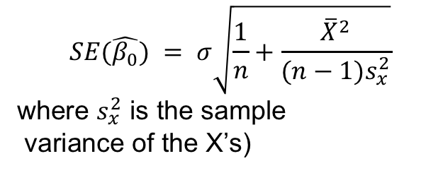
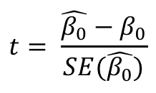
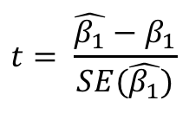
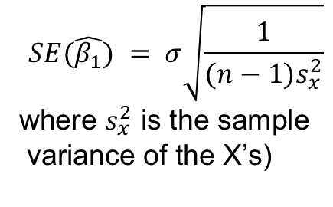
Parameter Estimation (Two Lightboards?)
Show the calculus behind estimating the intercept and the slope.
Show an example using the toy MPG versus Weight data set.
Mention the distribution of the sample intercept and slope and show the calculation of the t-statistic.
$$t= \frac{\hat{β_{0}}−β_{0}}{SE(\hat{β_{0}})}$$
$$SE(\hat{β_{0}}) = σ\sqrt{\frac{1}{n}+\frac{{\overline{X}}^{2}}{(n−1)s_{x}^{2}}}$$
where $s_{x}^{2}$ is the sample
variance of the X’s)
$$SE(\hat{β_{1}}) = σ\sqrt{\frac{1}{(n−1)s_{x}^{2}}}$$
where $s_{x}^{2}$ is the sample
variance of the X’s)
$$t= \frac{\hat{β_{1}}−β_{1}}{SE(\hat{β_{1}})}$$

Slide 42
R, Pvalue, and the Parameter Estimate Table

Slide 43
SLR | R and The Parameter Estimate Table
Show the example of the MPG versus Weight example verifying y intercept and slope using the lm() function in R.
Show R simulation of many sample intercepts from a known distribution. (Live Session will ask students to do this for the slope! and do the histogram in ggplot). Show that these sample intercepts follow a normal looking distribution.
Show the parameter estimate table and show how the t statistic and p-value are calculated.
Underline the hypothesis tests that are being described in the parameter estimate tables. Even show the calculations of the t-statistics
Reiterate the sum of the residuals = 0.
Reidentify the RMSE calculation and what it means.

Slide 44
## Simulating Slope / By hand and with a loop
```{r}
### now lets simulate more samples from distributions described by beta_0 = 50 and beta_1 = -10 and sigma = 2
### When Weight = 1 (1000 lbs) Mu = 40
simWeight1 = rnorm(3,40,2)
### When Weight = 2 (2000 lbs) Mu = 30
simWeight2 = rnorm(3,30,2)
### When Weight = 3 (3000 lbs) Mu = 20
simWeight3 = rnorm(3,20,2)
### make the coresponding weights
weights = c(1,1,1,2,2,2,3,3,3)
### make a data frame so we can use lm() and ggplot()
dffullSample = data.frame( Weight = weights, MPG = c(simWeight1,simWeight2,simWeight3))
### plot the data
dffullSample %>% ggplot(aes(x = Weight, y = MPG)) + geom_point()
### plot the data and the line
dffullSample %>% ggplot(aes(x = Weight, y = MPG)) + geom_point() + geom_smooth(method = "lm")
### get the sample intercept and slope
fit = lm(MPG~Weight, data = dffullSample)
fit$coefficients[1]
fit$coefficients[2]

Slide 45
## Loop for simulating many sample and thus many sample intercepts
```{r}
#now let's put it in a loop and see if we can see the distribution of the intercept
# remember that mu = 50-10*Weight and sigma = 2
#Holds the generated sample intercepts
sampInterceptHolder = c()
numSampIntercepts = 10000
for (i in 1:numSampIntercepts)
{
#now lets simulate more samples from distributions described by beta_0 = 50 and beta_1 = -10 and sigma = 2
#When Weight = 1 (1000 lbs) Mu = 40
simWeight1 = rnorm(3,40,2)
#When Weight = 2 (2000 lbs) Mu = 30
simWeight2 = rnorm(3,30,2)
#When Weight = 3 (3000 lbs) Mu = 20
simWeight3 = rnorm(3,20,2)
# make the coresponding weights
weights = c(1,1,1,2,2,2,3,3,3)
#make a data frame so we can use lm() and ggplot()
dffullSample = data.frame(Weight = weights, MPG = c(simWeight1,simWeight2,simWeight3))
#get the sample intercept and slope
fit = lm(MPG~Weight, data = dffullSample)
sampInterceptHolder[i] = fit$coefficients[1]
}
#Used a simple histogram (rather than from ggplot) since not for presentation
hist(sampInterceptHolder, main = str_c("Distribution of Intercpets from ", numSampIntercepts, " Samples"), xlab = "Sample Intercpet")
summary(sampInterceptHolder)
```

Slide 46
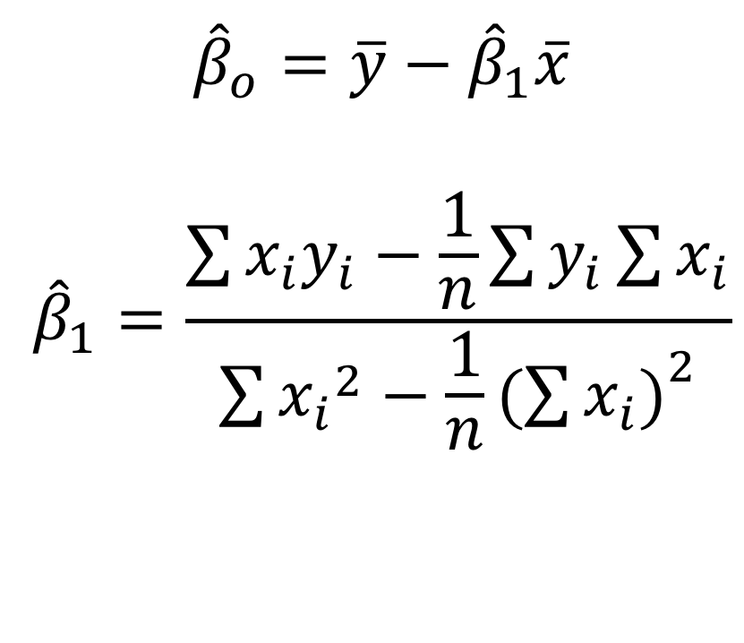
Parameter Estimates
$${\hat{β}}_{o}=\overline{y}−{\hat{β}}_{1}\overline{x}$$
$${\hat{β}}_{1}=\frac{\sum{x_{i}y_{i}−\frac{1}{n}\sum{y_{i}}\sum{x_{i}}}}{\sum{{x_{i}}^{2}}−\frac{1}{n}{(\sum{x_{i})}}^{2}}$$

Slide 47
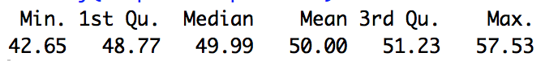
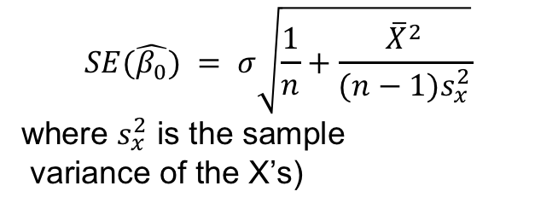
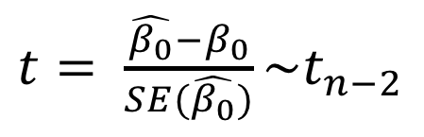
SLR | R and The Parameter Estimate Table
$t= \frac{\hat{β_{0}}−β_{0}}{SE(\hat{β_{0}})}\sim t_{n−2}$
$$SE(\hat{β_{0}}) = σ\sqrt{\frac{1}{n}+\frac{{\overline{X}}^{2}}{(n−1)s_{x}^{2}}}$$
where $s_{x}^{2}$ is the sample
variance of the X’s)

Slide 48
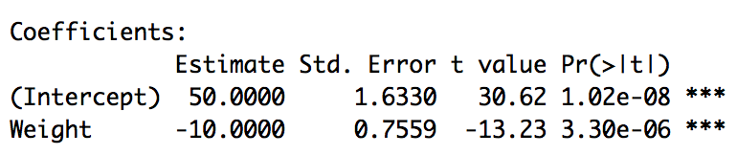
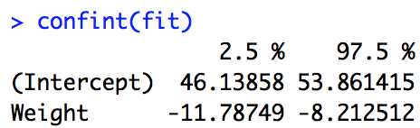
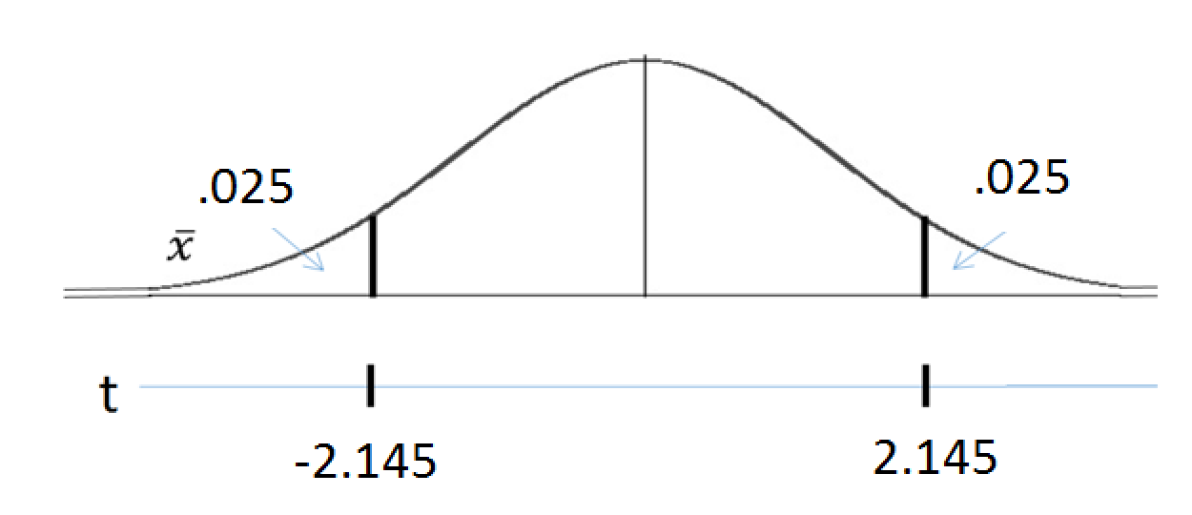
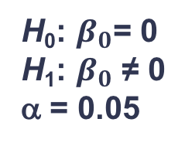
SLR | R and The Parameter Estimate Table
fit = lm(MPG~Weight, data = dfMPG)
summary(fit)
confint(fit)
H₀: $β_{0}$= 0
H₁: $β_{0}$ ≠ 0
α = 0.05
-30.62
30.62
There is overwhelming evidence to suggest that the intercept is different from zero (pvalue < .00001). Our best estimate is 50 and we are 95% confident that the intercept is between 46.14 and 53.86.

Slide 50
SLR | Example: MPG versus Weight

Slide 51
mtcars: MPG v. Weight
QOIs:
Quantify the relationship between the mean mpg and the weight of the car.
We have new Mercedes that weighs 2,304 lbs and we would like to estimate the mean mpg based only on this information.

Slide 52
mtcars: MPG v. Weight
mtcars %>% ggplot(aes(x = wt, y = mpg)) + geom_point() + ggtitle("mtcars: mpg v. weight") + xlim(0,6)
Assumptions:
There does not seem to be much evidence against normal distributions of mpgs for fixed levels of weight.
There does not seem to be much evidence against a linear relationship between the means of those assumed normal distributions and weight for cars that weigh less than 4500 lbs.
There does not seem to be much evidence of non-constant standard deviation of the normal distributions.
We will assume the mpgs are independent of one another (which may be a weak assumption.)
We will thus narrow the domain and build a model only for cars that weigh between 1000 and 4500 lbs.

Slide 53
mtcars: MPG v. Weight
mtcars %>% filter(wt < 5) %>% ggplot(aes(x = wt, y = mpg)) + geom_point() + ggtitle("mtcars: mpg v. weight") + xlim(0,6)
Assumptions:
There does not seem to be much evidence against normal distributions of mpgs for fixed levels of weight.
There does not seem to be much evidence against a linear relationship between the means of those assumed normal distributions and weight for cars that weigh less than 4500 lbs.
There does not seem to be much evidence of non-constant standard deviation of the normal distributions.
We will assume the mpgs are independent of one another (which may be a weak assumption.)
We will thus narrow the domain and build a model only for cars that weigh between 1000 and 4500 lbs.

Slide 54
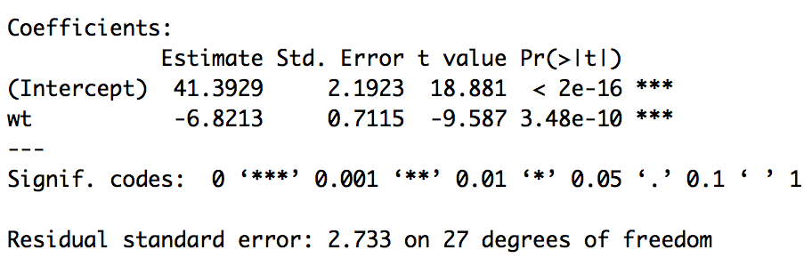
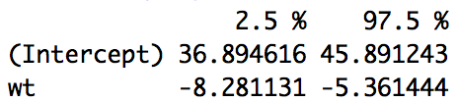
mtcars: MPG v. Weight
QOI 1:
Quantify the relationship between the mean miles per gallon and the weight of the car.
mtcars %>%
filter(wt < 4.5) %>%
ggplot(aes(x = wt, y = mpg)) + geom_point() + ggtitle("mtcars: mpg v. weight") + geom_smooth(method = "lm") + xlim(0,6)
mtcars2 = mtcars %>% filter(wt < 4.5)
fit = lm(mpg~wt, mtcars2)
summary(fit)
confint(fit)
For cars that weigh less that 4,500lb, for every 1000 lbs increase in the weight of the car, it is estimated that the mean miles per gallon will decrease by 6.82 miles per gallon. We are 95% confident that this decrease will be between 5.36 and 8.28 miles per gallon.

Slide 55
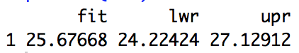
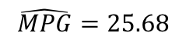
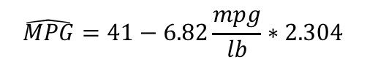
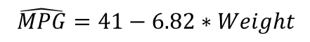
mtcars: MPG v. Weight
QOI 2:
We have new Mercedes that weighs 2,304 lbs and we would like to estimate the mean mpg based only on this information.
mtcars2 = mtcars %>% filter(wt < 4.5)
fit = lm(mpg~wt, mtcars2)
$$\hat{MPG}=41−6.82∗Weight$$
$$\hat{MPG}=41−6.82\frac{mpg}{lb}∗2.304$$
mercedes = data.frame(wt = 2.304)
predict(fit, newdata = mercedes, interval = "confidence")
$$\hat{MPG}=25.68$$
The estimated mean miles per gallon for the new Mercedes that weighs 2,304 lbs is 25.68 miles per gallon. We are 95% confident that the mean mpg is between 24.22 and 27.13 miles per gallon.

Slide 56
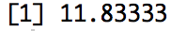
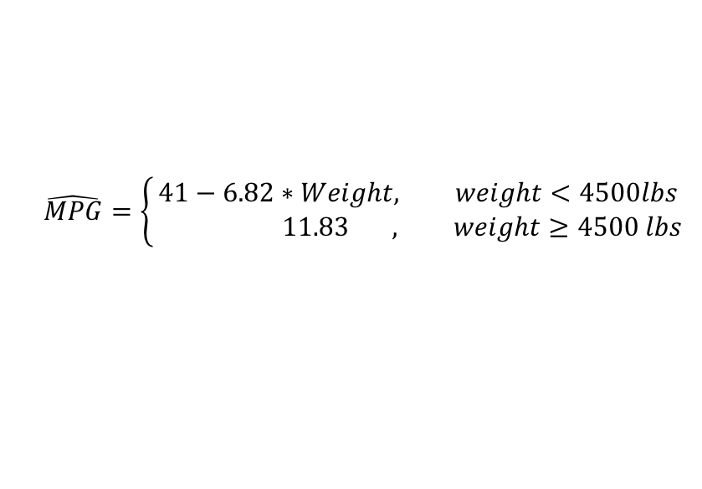
mtcars: MPG v. Weight
QOI1 and 2 with full data:
How do we handle the cars that weigh more than 4500 lbs?
mean((mtcars %>% filter(wt>4.5))$mpg)
$$\hat{MPG}=\left\{\begin{aligned}41−6.82∗Weight, weight<4500lbs \\ & 11.83 , weight≥4500 lbs\end{aligned}\right.$$
QOI 1: For cars that weigh less that 4,500 lbs, for every 1000 lbs increase in the weight of the car, it is estimated that the mean miles per gallon will decrease by 6.82 miles per gallon. We are 95% confident that this decrease will be between 5.36 and 8.28 miles per gallon. For cars that weigh more than 4,500 lbs, the estimated mpg is constantly estimated to be 11.88 mpg.
QOI 2: The estimated mean miles per gallon for the new Mercedes that weighs 2,304 lbs is 25.68 miles per gallon. We are 95% confident that the mean mpg is between 24.22 and 27.13 miles per gallon. For cars that weigh more than 4,500 lbs, the estimated mpg is constantly estimated to be 11.88 mpg.

Slide 58
Extensions | Transformations

Slide 59
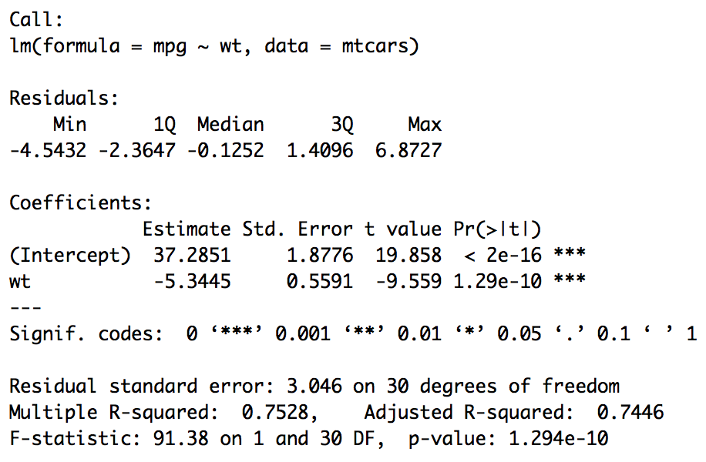
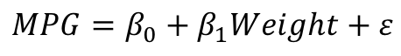
Recall: mpg versus weight
$$MPG=β_{0}+β_{1}Weight+ε$$
mtcars %>%
ggplot(aes(x = wt, y = mpg)) + geom_point() + ggtitle("mtcars: mpg v. weight") +geom_smooth(method = "lm") + xlim(0,6)
fit = lm(mpg~ wt, data = mtcars)
summary(fit)

Slide 60
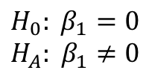
Recall: mpg versus weight
$$MPG=β_{0}+β_{1}Weight+ε$$
fit = lm(mpg~ wt, data = mtcars)
summary(fit)
$$H_{0}: β_{1}=0$$
$$H_{A}: β_{1}≠0$$
There is overwhelming evidence to suggest that the slope parameter with respect to the weight variable is not equal to zero (pvalue < .0001). In other words, there is overwhelming evidence to suggest that the miles per gallon is linearly related to the weight of the car.

Slide 61
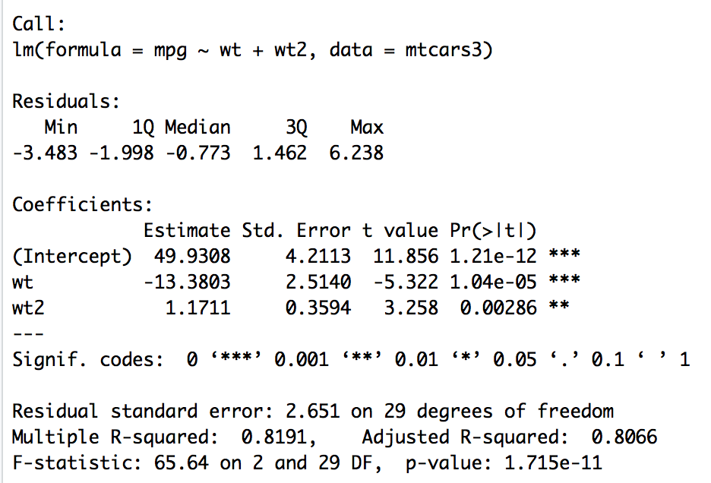
Consider the model: mpg versus weight and weight²
$$MPG=β_{0}+β_{1}Weight+β_{2}{Weight}^{2}+ε$$
preds = predict(fit)
mtcars %>%
ggplot(aes(x = wt, y = mpg)) +
geom_point() +
geom_line(data = mtcars, aes( x = wt, y = preds, col = "red", lwd = 1))
mtcars3 = mtcars %>% mutate(wt2 = wt^2)
fit = lm(mpg~wt+wt2, mtcars3)
summary(fit)

Slide 62
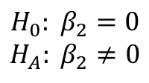
Recall: mpg versus weight
$$MPG=β_{0}+β_{1}Weight+β_{2}{Weight}^{2}+ε$$
fit = lm(mpg~ wt, data = mtcars)
summary(fit)
$$H_{0}: β_{2}=0$$
$$H_{A}: β_{2}≠0$$
There is strong evidence to suggest that the slope parameter with respect to the weight squared variable is not equal to zero (pvalue = .00286). That is, there is sufficient evidence to suggest that there is a quadratic relationship between miles per gallon and the weight of the car.

Slide 63
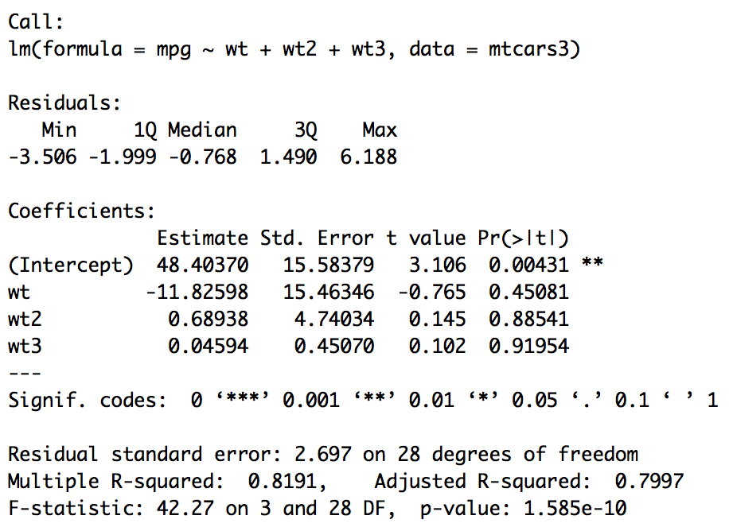
Consider the model: mpg versus weight and weight²
$$MPG=β_{0}+β_{1}Weight+β_{2}{Weight}^{2}+β_{3}{Weight}^{3}+ε$$
mtcars3 = mtcars %>% mutate(wt2 = wt^2, wt3 = wt^3)
fit = lm(mpg~wt+wt2+wt3, mtcars3)
preds = predict(fit)
mtcars %>% ggplot(aes(x = wt, y = mpg)) + geom_point() +geom_line(data = mtcars, aes( x = wt, y = preds, col = "red"))
mtcars3 = mtcars %>% mutate(wt2 = wt^2, wt3 = wt^3)
fit = lm(mpg~wt+wt2, mtcars3)
summary(fit)

Slide 64
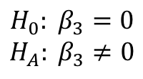
Recall: mpg versus weight
$$MPG=β_{0}+β_{1}Weight+β_{2}{Weight}^{2}+β_{3}{Weight}^{3}+ε$$
fit = lm(mpg~ wt, data = mtcars)
summary(fit)
$$H_{0}: β_{3}=0$$
$$H_{A}: β_{3}≠0$$
There not enough evidence to suggest that the slope parameter with respect to the weight variable cubed is not equal to zero (pvalue = .91954). That is, there is not enough evidence to suggest that there is a cubic relationship between miles per gallon and weight.

Slide 65
Recall: mpg versus weight
$$MPG=β_{0}+β_{1}Weight+β_{2}{Weight}^{2}+ε$$
fit = lm(mpg~ wt, data = mtcars)
summary(fit)
$$H_{0}: β_{2}=0$$
$$H_{A}: β_{2}≠0$$
There is strong evidence to suggest that the slope parameter with respect to the weight squared variable is not equal to zero (pvalue = .00286). That is, there is sufficient evidence to suggest that there is a quadratic relationship between miles per gallon and the weight of the car. This will be our final model.

Slide 67
Extensions | Adding Predictors / MLR

Slide 68
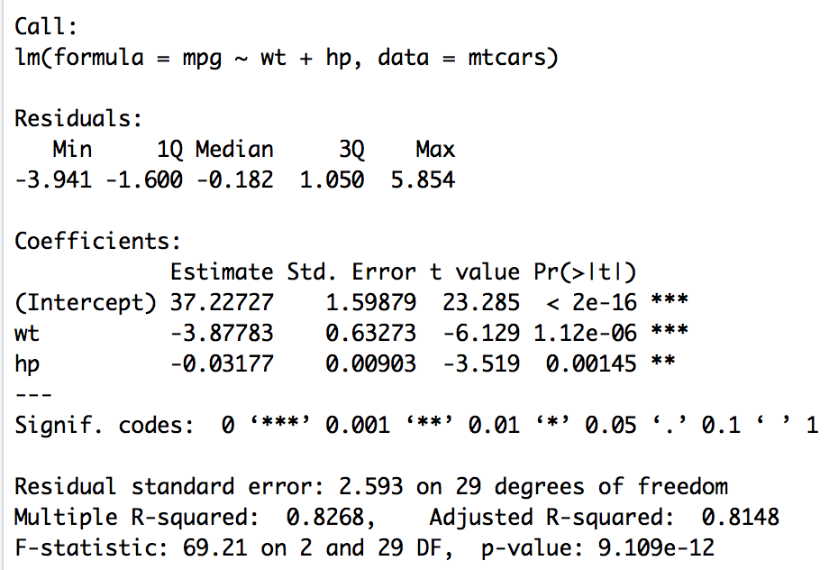
Example: MPG v. Weight and Horsepower
$$MPG=β_{0}+β_{1}Weight+β_{2}HorsePower+ε$$
fit = lm(mpg ~ wt + ht, data = mtcars)
summary(fit)

Slide 69
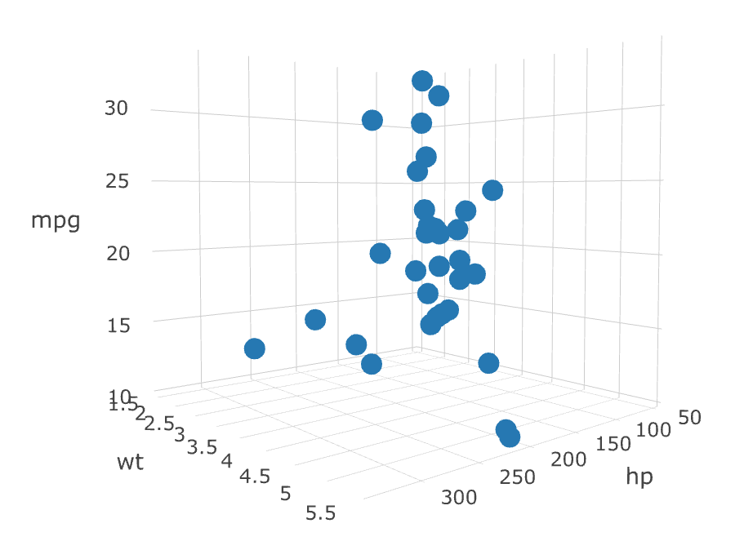
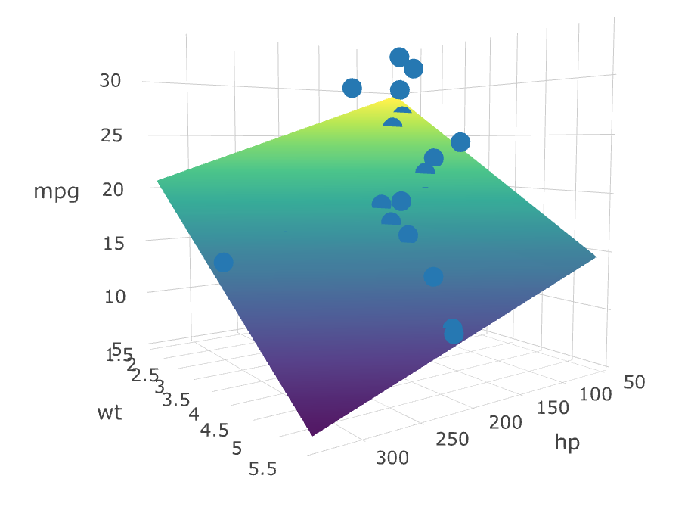
Example: MPG v. Weight and Horsepower
$$MPG=β_{0}+β_{1}Weight+β_{2}HorsePower+ε$$

Slide 70
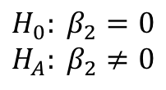

Example: MPG v. Weight and Horsepower
$$MPG=β_{0}+β_{1}Weight+β_{2}HorsePower+ε$$
fit = lm(mpg ~ wt + ht, data = mtcars)
summary(fit)
$$H_{0}: β_{1}=0$$
$$H_{A}: β_{1}≠0$$
There is overwhelming evidence to suggest that the slope parameter with respect to the weight variable is not equal to zero (pvalue < .00001). Our best estimate is -3.878
$$H_{0}: β_{2}=0$$
$$H_{A}: β_{2}≠0$$
There is overwhelming evidence to suggest that the slope parameter with respect to the horse power variable is not equal to zero (pvalue < .00001).
Our best estimate is -.03177

Slide 71
Example: MPG v. Weight and Horsepower
$$MPG=β_{0}+β_{1}Weight+β_{2}HorsePower+ε$$
fit = lm(mpg ~ wt + ht, data = mtcars)
summary(fit)
Holding horsepower constant, for every additional 1000lbs the car weighs it is estimated that the mean mpg decreases 3.87 miles per gallon.
Holding the weight of the car constant, for every additional horsepower the mean mpg is estimated to decrease by .032.
Holding the weight of the car constant, for every 10 additional horsepower the mean mpg is estimated to decrease by 0.3.

Slide 72

Example: MPG v. Weight and Horsepower
fit = lm(mpg ~ wt + ht, data = mtcars)
summary(fit)
preds = predict(fit)
preds
mtcars$predMPG = preds

Slide 74
Adding Predictors / Assumptions of MLR and the Curse of Dimensionality

Slide 75
Assumptions: MLR
The relationship between the independent and dependent variables is linear.
The distribution of the response for fixed values of the explanatory variables is normal.
The distribution of the residuals is normal.
The normal distributions of the response should have constant variance (standard deviation) for fixed values of the explanatory variables.
The normal distributions of the residuals should have constant variance (standard deviation) for fixed values of the explanatory variables.
Explanatory variables are independent of one another. (No multicollinearity).
Observations are independent of one another.

Slide 76

Plot of Assumptions Being Met
ASSUMPTONS OF MLR
The relationship between the independent and dependent variables is linear.
The distribution of the response for fixed values of the explanatory variables is normal.
The distribution of the residuals is normal.
The normal distributions of the responses should have constant variance (standard deviation) for fixed values of the explanatory variables.
The normal distributions of the residuals should have constant variance (standard deviation) for fixed values of the explanatory variables.
Explanatory variables are independent of one another. (No multicollinearity).
Observations are independent of one another.
?
?

Slide 77


Plot of Assumptions Being Met
$$z=4+3x−7y+ ε ε\sim N(0,7)$$
ASSUMPTONS OF MLR
The relationship between the independent and dependent variables is linear.
The distribution of the response for fixed values of the explanatory variables is normal.
The distribution of the residuals is normal.
The normal distributions of the responses should have constant variance (standard deviation) for fixed values of the explanatory variables.
The normal distributions of the residuals should have constant variance (standard deviation) for fixed values of the explanatory variables.
Explanatory variables are independent of one another. (No multicollinearity).
Observations are independent of one another.

Slide 78



Histogram and Scatterplot of Residuals
fit = lm(z~x + y, data = df)
hist(fit$residuals, col = "blue", main = "Histogram of Residuals")
plot(fit$fitted.values,fit$residuals, main = "Plot of Residuals v. Fitted Values")
$$z=4+3x−7y+ ε ε\sim N(0,7)$$
ASSUMPTONS OF MLR
The relationship between the independent and dependent variables is linear.
The distribution of the response for fixed values of the explanatory variables is normal.
The distribution of the residuals is normal.
The normal distributions of the responses should have constant variance (standard deviation) for fixed values of the explanatory variables.
The normal distributions of the residuals should have constant variance (standard deviation) for fixed values of the explanatory variables.
Explanatory variables are independent of one another. (No multicollinearity).
Observations are independent of one another.
Notes:
Change last argument in the sample function call to 1 and change the first argument of the rnorm call and change the limit in the for loop in the R code for this part.

Slide 79
Histogram and Scatterplot of Residuals
$$z=4+3x−7y+ ε ε\sim N(0,7)$$
These should look evenly scattered around 0. Why do they look shifted for some fitted values?
These should look normally distributed. Why the right skew?
Notes:
Change last argument in the sample function call to 1 and change the first argument of the rnorm call and change the limit in the for loop in the R code for this part.

Slide 80

Scatterplots and Correlations
$$z=4+3x−7y+ ε ε\sim N(0,7)$$
library(GGally)
df %>% ggpairs()
ASSUMPTONS OF MLR
The relationship between the independent and dependent variables is linear.
The distribution of the response for fixed values of the explanatory variables is normal.
The distribution of the residuals is normal.
The normal distributions of the responses should have constant variance (standard deviation) for fixed values of the explanatory variables.
The normal distributions of the residuals should have constant variance (standard deviation) for fixed values of the explanatory variables.
Explanatory variables are independent of one another. (No multicollinearity).
Observations are independent of one another.
The strong negative correlation with z and y makes sense.
What is going on with z at x = 6?
Notes:
Change last argument in the sample function call to 1 and change the first argument of the rnorm call and change the limit in the for loop in the R code for this part.

Slide 81
Assumptions: MPG v. Weight and Horsepower
$$\hat{MPG}=37.2−3.9Weight−.03Horsepower+ ε ε\sim N(0,7)$$

Slide 82
MPG v. Weight

Slide 83

MPG v. Weight

Slide 84

MPG v. Weight v. Horsepower

Slide 85

MPG v. Weight v. Horsepower

Slide 86
MPG v. Weight v. Horsepower
?
?

Slide 87

Plot of Assumptions Being Met
$$\hat{MPG}=37.2−3.9Weight−.03Horsepower ε\sim N(0,7)$$
ASSUMPTONS OF MLR
The relationship between the independent and dependent variables is linear.
The distribution of the response for fixed values of the explanatory variables is normal.
The distribution of the residuals is normal.
The normal distributions of the responses should have constant variance (standard deviation) for fixed values of the explanatory variables.
The normal distributions of the residuals should have constant variance (standard deviation) for fixed values of the explanatory variables.
Explanatory variables are independent of one another. (No multicollinearity).
Observations are independent of one another.

Slide 88
MPG Data: A Necessary But Not Sufficient Check
$$\hat{MPG}=37.2−3.9Weight−.03Horsepower+ ε ε\sim N(0,7)$$
library(GGally)
mtcars %>% select(mpg,wt,hp) %>% ggpairs()
ASSUMPTONS OF MLR
The relationship between the independent and dependent variables is linear.
The distribution of the response for fixed values of the explanatory variables is normal.
The distribution of the residuals is normal.
The normal distributions of the responses should have constant variance (standard deviation) for fixed values of the explanatory variables.
The normal distributions of the residuals should have constant variance (standard deviation) for fixed values of the explanatory variables.
Explanatory variables are independent of one another. (No multicollinearity).
Observations are independent of one another.

Slide 89

MPG Data: A Necessary But Not Sufficient Check
$$\hat{MPG}=37.2−3.9Weight−.03Horsepower+ ε ε\sim N(0,7)$$
fit = lm(mpg~wt+hp, data = mtcars)
hist(fit$residuals, col = "blue", main = "Histogram of Residuals")
plot(fit$fitted.values,fit$residuals, main = "Plot of Residuals v. Fitted Values")
library(GGally)
mtcars %>% select(mpg,wt,hp) %>% ggpairs()
ASSUMPTONS OF MLR
The relationship between the independent and dependent variables is linear.
The distribution of the response for fixed values of the explanatory variables is normal.
The distribution of the residuals is normal.
The normal distributions of the responses should have constant variance (standard deviation) for fixed values of the explanatory variables.
The normal distributions of the residuals should have constant variance (standard deviation) for fixed values of the explanatory variables.
Explanatory variables are independent of one another. (No multicollinearity).
Observations are independent of one another.

Slide 90
MPG Data: A Necessary But Not Sufficient Check
$$\hat{MPG}=37.2−3.9Weight−.03Horsepower+ ε ε\sim N(0,7)$$
fit = lm(mpg~wt+hp, data = mtcars)
hist(fit$residuals, col = "blue", main = "Histogram of Residuals")
plot(fit$fitted.values,fit$residuals, main = "Plot of Residuals v. Fitted Values")
library(GGally)
mtcars %>% select(mpg,wt,hp) %>% ggpairs()
ASSUMPTONS OF MLR
The relationship between the independent and dependent variables is linear.
The distribution of the response for fixed values of the explanatory variables is normal.
The distribution of the residuals is normal.
The normal distributions of the responses should have constant variance (standard deviation) for fixed values of the explanatory variables.
The normal distributions of the residuals should have constant variance (standard deviation) for fixed values of the explanatory variables.
Explanatory variables are independent of one another. (No multicollinearity).
Observations are independent of one another.

Slide 91
George Box
”All models are wrong, but some are useful.”
-George Box

Slide 93
Cross Validation

Slide 94

Evaluating / Validating Models
$$MSPE= \frac{\sum_{i=1}^{n}{{(x_{i}−{\tilde{x}}_{i})}^{2}}}{n}$$
$x_{i}$ is the observed value and ${\tilde{x}}_{i}$ is the predicted value.
Mean Square Prediction Error (MSPE)
Lower is better. It is a statistic that is a function of the distance the predictions are from the actual values … again smaller is better.

Slide 95









Cross Validation
Training Set
Test Set
MODEL
$$MSPE= \frac{\sum_{i=1}^{n}{{(x_{i}−{\tilde{x}}_{i})}^{2}}}{n}$$
$${\tilde{x}}_{i}$$
$$x_{i}$$

Slide 96



How to Choose the Train and Test Sets?
Things to Consider:
General guidance is to use 10 observations per parameter you are estimating.
Select observations to training and test sets randomly to protect against bias.
General guidance is about 2/3 to ¾ Training and 1/3 to ¼ Test.

Slide 97
Putting it All Together: Steps in Cross Validation
Divide the data set with responses into a ”Training Set” and a “Test Set”.
Train a model on the Training Set. (“Train” = estimate parameters.)
Generate prediction using this model for the Test Set explanatory variables.
Find the MSPE using the predictions and the actual values from the Test Set.
Repeat 2 – 4 for competing models.
Compare MSPEs of Competing Models.

Slide 98

Putting it All Together!
Divide the data set with responses into a ”Training Set” and a “Test Set”.

Slide 99

Putting it All Together!
2. Train a model on the Training Set.

Slide 100

Putting it All Together
3. Generate prediction using this model for the Test Set explanatory variables.

Slide 101


Putting it All Together
4. Find the MSPE using the predictions and the actual values from the Test Set.
or

Slide 102



Putting it All Together
5. Repeat 2 - 4 for competing models.

Slide 103
Putting it All Together
6. Compare MSPEs of Competing Models.
Model | MSPE
Model 1 | 49.94
Model2 | 52.09

Slide 104
A More Stable MSPE
numMSPEs = 1000
MSPEHolderModel1 = numeric(numMSPEs)
MSPEHolderModel2 = numeric(numMSPEs)
for (i in 1:numMSPEs)
{
TrainObs = sample(seq(1,dim(NBA)[1]),round(.75*dim(NBA)[1]),replace = FALSE)
NBATrain = NBA[TrainObs,]
NBATrain
NBATest = NBA[-TrainObs,]
NBATest
Model1_fit = lm(APPG ~ Height+Weight+FG+FT, data = NBATrain)
Model1_Preds = predict(Model1_fit, newdata = NBATest)
#MSPE Model 1
MSPE = mean((NBATest$APPG - Model1_Preds)^2)
MSPE
MSPEHolderModel1[i] = MSPE
#Model 2
Model2_fit = lm(APPG ~ Height + FG, data = NBATrain)
Model2_Preds = predict(Model2_fit,newdata = NBATest)
MSPE = mean((NBATest$APPG - Model2_Preds)^2)
MSPE
MSPEHolderModel2[i] = MSPE
}
mean(MSPEHolderModel1)
mean(MSPEHolderModel2)

Slide 106
For Live Session
Have students create residual plots for SLR models in the videos. Ask them to imagine what the residual plot should look like if the assumptions are met and what it can look like when they are violated in some ways.
Fit an MLR model with mpg = weight + hp + hp^2 and see if that fits better in terms of assumptions …. live instructor will show the results.
Possibly adapt code to sample more x,y,points or more from the points to show assumptions better. We could just have live session instructor do this in class. But I think we should have them try.
Students may ask questions about the code that plots the regression surface
Add an interaction term to the mpg = weight + horsepower model from the videos. (It is significant.)
Discussion Question for videos in cross validation. “Run a CV for at least three different random Train/Test splits. Record your MSPE (at least 3 of them) and provide at least a sentence describing your thoughts after inspecting the MSPEs.
Do lot’s of interpreting slopes and intercepts
For Live Session Bonus:
Using the code used to show the assumptions of MLR, the plotly surface plots), generate for all x/y combinations rather than just the 10 we did in the videos. Use ggpairs() to show the relationship between z and x. Is it more linear this time?

